Slide 1
TIME AND WORK

Slide 2
TIME & WORK
Efficiency Technique
Work done by a person in unit time is defined as efficiency in Time and Work
Problems
A can complete a work in 10 days so efficiency of A per day = 100/10 = 10%
LCM Method to Solve Problems
1.we take the LCM of time taken by the members to do the complete work
2.That LCM will behave as a value of total work
3.Total Work = LCM
4.Total Work = No of days * work done in 1 day (per unit time)
Thus, No of days = Work/Efficiency
where efficiency = work done in per unit time

Slide 3
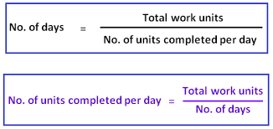
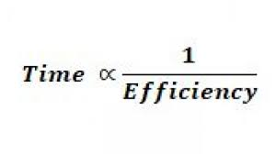
TIME & WORK
Some important Formula:

Slide 4
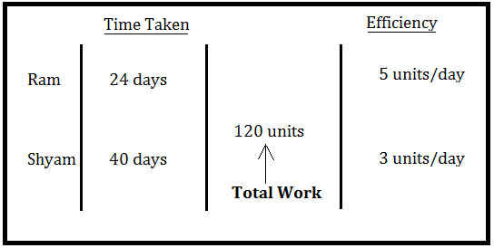
Case-1 : When 2 person involve in a task
Example :
Two persons Ram and Shyam can do a certain task in 24 and 40 days. If they will stat together to do this task then in how many days they together can do this task.

Slide 5
Practice Question
Two persons A and B can do a certain task in 20 days and 30 days. If they will start together to do this task then in how many days they together can do this task. a.10 b.12 c.13 d.14
Notes:
b

Slide 6
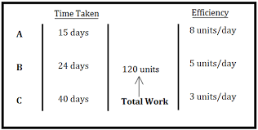
CASE-2 : when 3 persons involve in a task
Three persons A, B and C can do a certain task in 15 ,24 and 40 days. If they will stat together to do this task then in how many days they together can do this task.

Slide 7
Practice Question
Three persons A, B and C can do a certain task in 10 ,20 and 30 days. If they will start together to do this task then in how many days they together can do this task.
a.50/11 b.60/11 c.70/11 d.80/11
Notes:
b

Slide 8
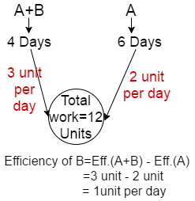
A and B together can do a task in 4 days and A alone can do this task in 6 days, then find B alone will take how many days to do this task?

Slide 9
Practice question
A and B together can do a task in 5 days and A alone can do this task in15 days, then find B alone will take how many days to do this task? a.6.5 b.7.5 c.8.5 d.9.5
Notes:
B

Slide 10
Practice Question
If B and C together can do a task in 8 days , A and B can do a task in 12 days and A and C can do this task in 6 days, then find all these three together can do this task in how many days?
a.17/3 b.16/3 c.13/3 d. none of these

Slide 11
Practice Question
If B and C together can do a task in 10 days , A and B can do a task in 20 days and A and C can do this task in 30 days, then find all these three together can do this task in how many days? a.110/11 b.120/11 c.130/11 d.140/11
Notes:
b

Slide 12
Practice question
A and B together can do a task in 12 days and A, B and C together can do this task in 8 days, then find C alone will take how many days to do this task? a.20 b.22 c.24 d.26
Notes:
C

Slide 13
Practice Question
A can do a work in 15 days and B in 20 days. If they work on it together for 4 days, then the fraction of the work that is left is :
a.8/15 b.7/15 c.7/13 d.6/17
Notes:
A

Slide 14
Practice Question
A can do a piece of work in 70 days and B is 40% more efficient than A. The number of days taken by B to do the same work is
(a) 40 days (b) 60 days (c) 50 days (d) 45 days
Notes:
A

Slide 15
Practice Question
A is 40% more efficient then B, they together completed the whole work in 15 days. In how much time B alone do the work?
(a) 36 days (b) 28 days (c) 24 days (d) 12 days
Notes:
A

Slide 16
Practice Question
A, B and C can do a piece of work in 20, 30 and 60 days respectively. In how many days can A do the work if he is assisted by B and C on every third day? a.10 b.12 c.15 d.18
Notes:
c

Slide 17
Case 4 : Alternate days concept
Example: A and B do a piece of work in 6 days and 9 days. They work on alternate days, starting with A on the first day. In how many days will the work be completed? a.7 b.8 c.9 d.10 Solution: Take LCM of 6 and 9 = 18 unit i.e total work A will do 3 unit /day B will do 2unit/day So, in 2 days, 5 unit work will complete means 6 days , 15 unit will complete. On 7th day, A again will start and complete 3 unit in 1 day So, total work will be completed in 7 days.

Slide 18
Practice Question
X and Y can do a piece of work in 9 days and 12 days respectively. If they work for a day alternatively, X beginning, in how many days will the work be completed?
a.10.25 b.11 c.11.25 d.12
Notes:
a

Slide 19
Practice Question
Sita and Gita can complete a work in 8 and 12 hours respectively. If they work in stretches of one hour alternatively, Sita beginning at 9 am then at what time the work will be completed?
(a) 5 : 30 pm (b) 6 : 00 am (c) 5 : 30 am (d) 6 : 30 pm
Notes:
a

Slide 20
Case 5 :Partial Work Done
A can do a piece of work in 15 days. B can do the same work in 25 days. Both together started the work and after 5 days B left the work. In how many days A complete the remaining work? 4days 5 days 7 days 12 days

Slide 21
Case 6 :Problem on wages
P can do as much work in 4 days as K can do in 6 days, and K can do as much work in 5 days as A in 8 days. What wages does A get for a piece of work which P can do in 80 days, if A gets Re. 1 for 1 day? Rs. 144 Rs. 124 Rs. 192 Rs. 130

Slide 22
Q can complete a piece of work in 12 days, W can complete the same work in 15 days and R can complete the work in 20 days. Doing that work together, they get an amount of Rs.108000. Find the sum of shares of Q and W. A. Rs. 56000 B. Rs. 81000 C. Rs. 42000 D. Rs. 49000

Slide 23
Miscellaneous Questions
‘A’ alone can do half of a work in 70 days. The time taken by B to do 1/4th of the work is equal to the time taken by A to do 1/3rd of the work. Find the number of days A and B together will take to complete the work A. 35 days B. 40 days C. 80 days D. 60 days
Notes:
c

Slide 24
Two workers A and B working together completed a job in 5 days. If A worked twice as efficiently as he actually did and B worked 1/3 as efficiently as he actually did, the work would have been completed in 3 days. To complete the job alone, A would require (a) 5 (1/5) days (b) 6 (¼) days (c) 7 (½) days (d) 8 (¾) days

Slide 25
A can build a wall in 10 days and B can destroy the wall in 15 days. If they works in alternate days starting with A, then in how many days the wall will be build? [a] 55 day [b] 66 day [c] 60 day [d] 59 day

Slide 26

Thank You

